Slide 1
Auidatory Pathway
Dr Reshmy K.R
Professor
Dept. of Physiology
SKHMC

Slide 2
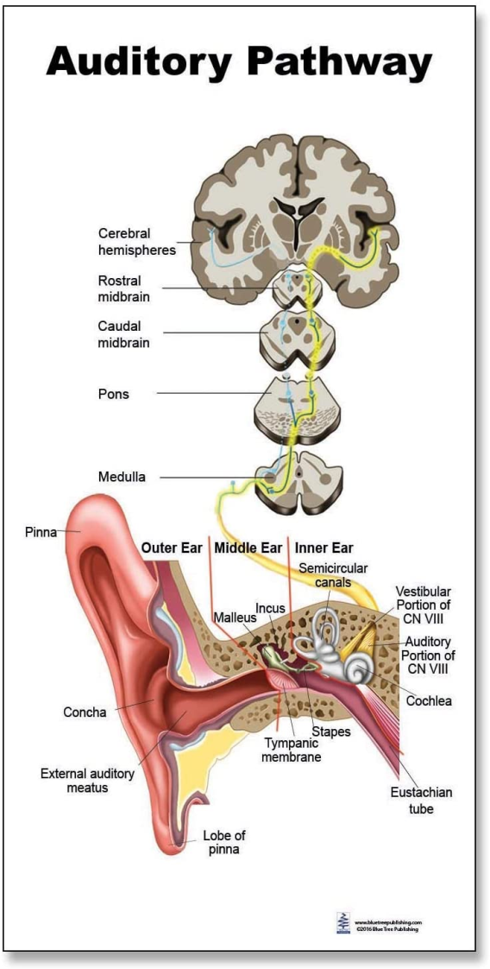
Auditory pathway
The fibers of auditory pathway pass through Cochlear division of vestibulocochlear nerve( VIII Cranial nerve).
It lies in the medulla oblongata, midbrain and thalamic region.
Center for hearing is in Temporal lobe of cerebral cortex where the fibers of auditory pathway finally terminate.
The fibers are both crossed and uncrossed so that each cochlea is represented in the cortex on both sides.

Slide 3
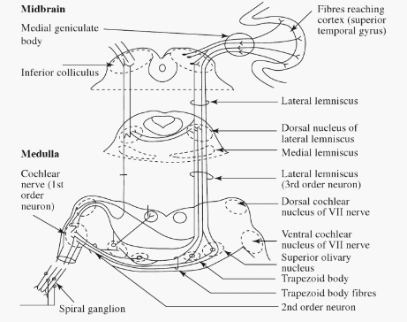
Ist Order neuron
Receptors of the auditory sensation-- Hair cells in Organ of Corti
--Outer hair cells & Inner hair cells
Ist Order neurons -Bipolar cells
The bipolar cells forms the Spiral ganglion situated in the modiolus of cochlea
The peripheral short processes (dendrites) of these cells are distributed around the hair cells of organ of Corti.

Slide 4
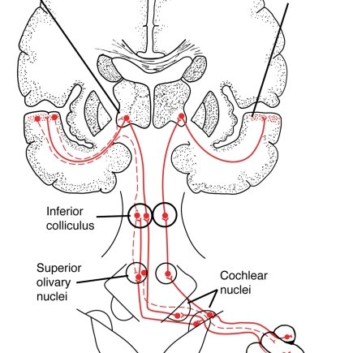
The long processes axons of these cells leave the internal auditory meatus, as the cochlear nerve.
The cochlear nerve leaves the internal auditory meatus and enters medulla oblongata.
Immediately after entering the medulla oblongata, the fibers divide into two groups.
Some fibers end in Ventral cochlear nucleus and remaining fibers end on Dorsal cochlear nucleus in Medulla oblongata.

Slide 5
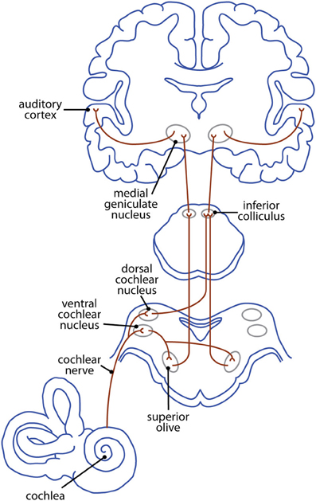
IInd order Neuron
--Cells of dorsal and ventral cochlear nuclei present in the medulla oblongata.
Axons of the second order neurons pass through a complex pathway, which runs in three different directions.
1. First group of fibers cross the midline and run to the opposite side to form trapezoid body.
----to the superior olivary nucleus.
----some fibers terminate at the sup. olivary nucleus of same side

Slide 6
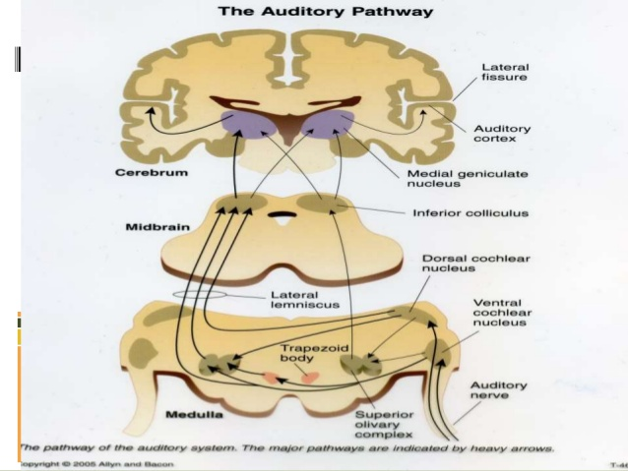
Second group of fibers run in the lateral lemniscus of the same side and terminate in the nucleus of lateral lemniscus of same side.
Third group of fibers run into reticular formation , cross the midline as intermediate trapezoid fibers and finally join the Nucleus of lateral lemniscus.

Slide 7
III ^{rd} order neurons
-- Superior olivary nuclei and Nucleus of lateral lemniscus.
The fibers of the third order neurons end in Medial geniculate body of thalamus.( subcortical auditory center)
Fibers pass to the temporal cortex, through internal capsule as auditory radiation.
Some of the auditory fibers from medial geniculate body go to Inferior colliculus of tectum in midbrain involved in reflex movement of head in response to auditory stimuli.

Slide 8
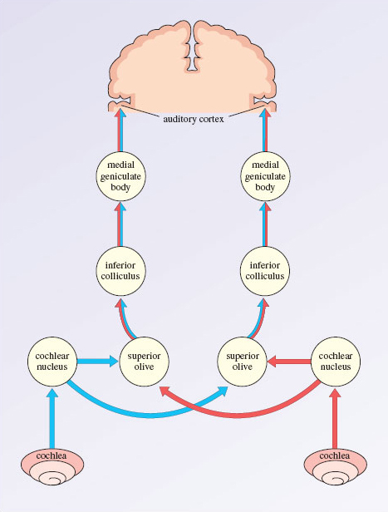
Cortical auditory centres
Situated in the temporal lobe of cerebral cortex.
Primary Auditory areas are 41, 42 and Wernickeis area.
-Perception of auditory impulses, analysis of pitch and intensity of sound , determination of source of sound
Auditopsychic area-analysis and interpretation of auditory sensation along with Wernicke's area.

Slide 9
References: https://www.open.edu/openlearn/science-maths-technology/biology/hearing/content-section-7.1 http://humanphysiology.academy/Neurosciences%202015/Chapter%203/A.3p%20Auditory%20Pathway.html
THANK YOU

